Slide 1
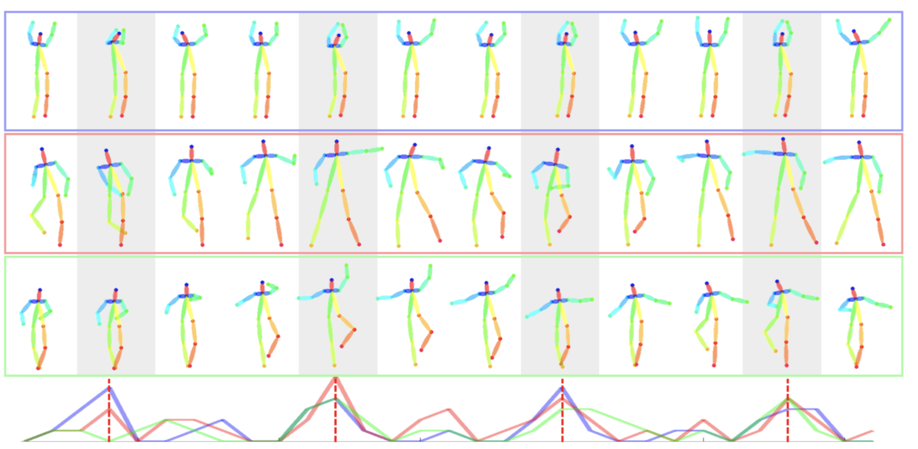
Dancing to Music
Han Yan, Weiyu Du
CIS 565 Final Project Milestone 3
Notes:
For ms3, we tried both directions we mentioned in our last presentation: improving current method, pose to image translation. We had both successes and failures in our attempts.

Slide 2
Pose to Image Translation
Video-to-Video Synthesis, Wang et al., Neurips 2018 ^{[1]}
Plan:
Collect a dataset of pose-to-video mapping
Train our own model
Apply using current prediction results
Challenge:
Need to obtain 2D pose ground truth from video, typically done through OpenPose, which struggled to work on our machine
Need abundant data for a single person
[1] Demo results from paper
[1] Ting-Chun Wang, Ming-Yu Liu, Jun-Yan Zhu, Guilin Liu, Andrew Tao, Jan Kautz, and Bryan Catanzaro. "Video-to-Video Synthesis", in NeurIPS, 2018.
Notes:
We first spend the first two days in the direction of pose to image translation. Through literature review, we found the video-to-video synthesis paper, which does image translation in different domains. One of its application is showcased on the right. We want to take advantage of their pose to body pipeline and train our own model. However, we need to first obtain 2D pose from video for our training data. This typically is done through OpenPose. We had a hard time installing the code on our server since it requires a gui and ours is a headless one. So we moved on from this direction.

Slide 3
Improve current model -- observations from dance results
Observation: in comparison to real videos, the dance movements are not well articulated and very far from typical “ballet” motion
The first question we should ask is:
→ Does it even know the music is ballet?
Then:
→ Is it because the network has trouble memorizing the ballet movements and retrieving a suitable sequence of poses?
Notes:
In our first direction, we want to start off with an observation we made in our previous results. That is, in comparison to real videos, our generation seems not well articulated and do not have typical ballet poses.
But a simple question we overlooked was: does the network even understand we’re supposed to generate ballet from the music?
A question we asked immediately is that whether this is because our model did not pick up the salient features in ballet dance or have trouble retrieving those? We designed a series of ablation for this.

Slide 4
Evaluation on music style classification
In current framework, we extract music features by running a classification task on music type: ballet, zumba, hiphop
Not only does this influence how good our music features are
But also which type of dance we’re generating in inference
Overall accuracy: 73.5%
 | Ballet | Zumba | Hiphop
Accuracy | 89.8% | 71.9% | 52.6%
Predicted as Ballet | -- | 4.8% | 36.8%
Predicted as Zumba | 4.3% | -- | 10.4%
Predicted as Hiphop | 5.8% | 23.2% | --
Frequent mistakes!
Notes:
Being able to classify music style is important also because we heavily use the features we obtained from the classification in our network. To make sure those features are the salient ones, we want to ensure we do well in differentiating different types of music, aka the classification task here. However, after running evaluation, we see that the overall accuracy is quite low for a three-way classification.

Slide 5
Evaluation on the impact of initial pose
In current framework, there is a specific network that learns the initial pose of every dance segment
→ Wish to see how results vary if we sample from a Gaussian distribution as our initial pose
Instead from all zeros
Dance generation from the same hiphop music, but four different initial pose (the frames are aligned)
Notes:
Another interesting thing we discover is how the dance generation is very much dependent on the initial pose.

Slide 6
Improve current model -- Ablation studies
A convoluted framework that resembles a blackbox -- we don’t really understand what’s going on
Lack of ablation studies from the original paper
Need to answer the following questions:
→ Which part of our current framework works and which doesn’t?
→ Are they doing what we expect them to do?

Slide 7
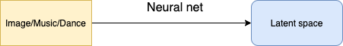
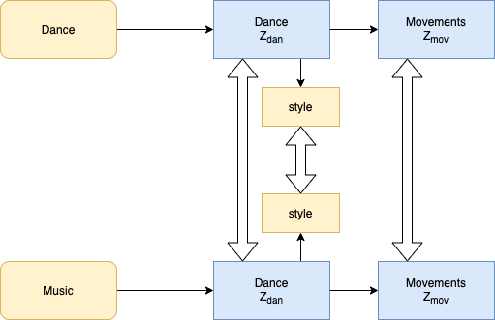
Ablation Studies Design
(1) Alignment of latent dance codes
(2) Alignment between music style and dance style
(3) Alignment of latent movement sequences
(1)
(2)
(3)
We want to try removing each of the constraints in these alignments to see which alignment contributes most to the performance and whether any of them is unnecessary.

Slide 8
Ablation Studies Result -- Music Style Regression
Conclusion:
Style understanding is the current bottleneck, which is very unexpected from a state-of-the-art method
Ablation (without music style and dance style alignment) - Ballet
Comparison (original model) - Ballet

